Slide 1
Calories Burnt Detection

Slide 2

Dataset

Slide 3
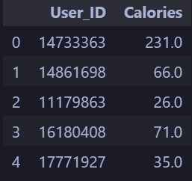

Slide 4
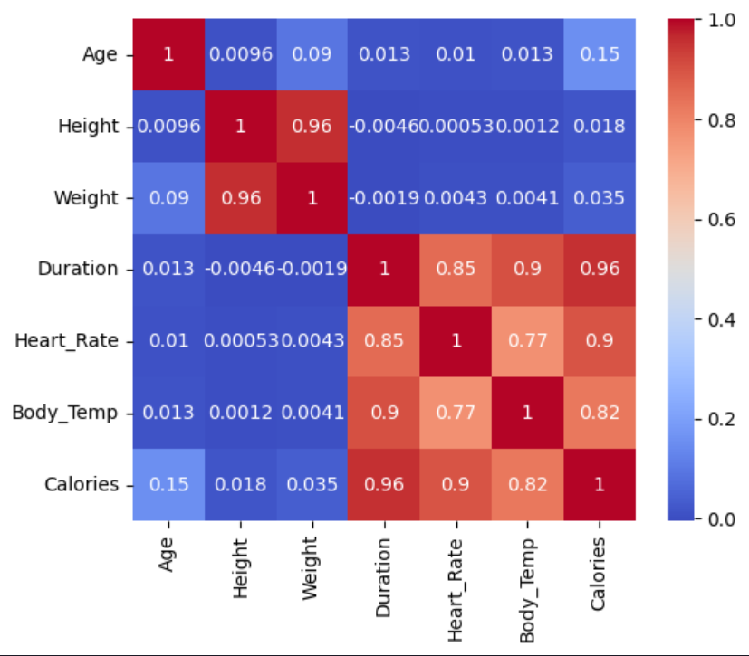
HeatMap

Slide 5
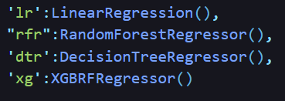

Types

Slide 6
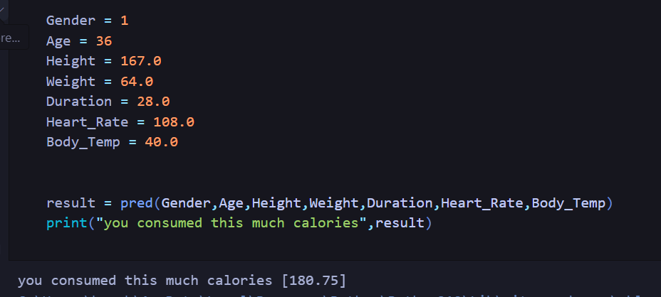
Prediction

Slide 7
Thank You!

